Slide 1
Efficiency Of The Drug For The Asthma Treatment Using Machine Learning Algorithms.
Prepared By-
Aishwarya Kamble.

Slide 2
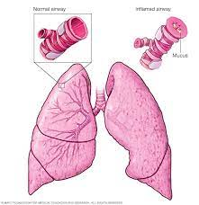
What is Asthma?
A condition in which your airways narrow and swell and may produce extra mucus.
This can make breathing difficult and trigger coughing, a whistling sound when you breath out and shortness of breath

Slide 3
How is machine learning related to Asthma?
Machine learning allows building models to quickly analyze data and deliver results, leveraging historical and real-time data.
With machine learning healthcare service provider can make better decisions on patient's diagnosis and treatment options, which leads to an overall improvement healthcare services.

Slide 4
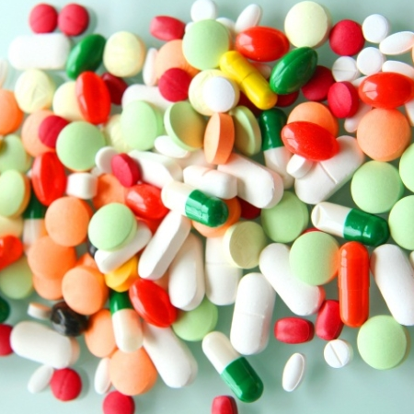
Problem Statement: find the efficiency of the drugs which the patients has been taking lately and to find out the effectiveness of the new drug as compared to the old one

Slide 5
Dataset:
Classification Algorithms: In Classification, a program learns from the given dataset or observations and then classifies new observation into a number of classes or groups.
Non-Linear
Skewness Present in the dataset
No null values present
Imbalance

Slide 6
How To Achieve Efficiency?
Collecting Data: As you know, machines initially learn from the data that you give them. ...
01
Preparing the Data: After you have your data, you have to prepare it. ...
02
Choosing a Model: ...
03
Training the Model: ...
04
Evaluating the Model: ...
05
Parameter Tuning: ...
06
Making Predictions.
07

Slide 7
1. Collecting Data:
The quality of the data that you feed to the machine will determine how accurate your model is.
Our data has no null values present.
has a good representation of the various subcategories/classes present.

Slide 8
2. Preparing the Data:
Cleaned the data- Removed unwanted column I.e PID and conversion of datatype.
Visualized the data with the help of Pairplot, Distplot, Heatmap, Piechart and barplot.
Split the data I.e have sent 30% data for testing and 70% for training.

Slide 9
Choosing a Model:
Have calculated the accuracy with the help of 3 models:
Random Forest
Decision Tree
Bagging(Ensemble technique)

Slide 10
4. Training the Model:
Have passed the prepared data to my machine learning model to find patterns and make predictions.

Slide 11
5. Evaluating the Model:
After training you have to check to see how your model is performing.
This is done by testing the performance of the model on previously unseen data. The unseen data used is the testing set that you split our data into earlier

Slide 12
6. Parameter Tuning:
Once you have created and evaluated your model, see if its accuracy can be improved in any way. This is done by tuning the parameters present in your model.

Slide 13
7. Making Predictions
My model has predicted that the previously taken drugs by the patient were less effective than the newly taken drugs by the patients.
Patients who has been taking drug_s or drug_d is greater than the Pre Drug Consumption I.e they were taking some other drugs before.

Slide 14
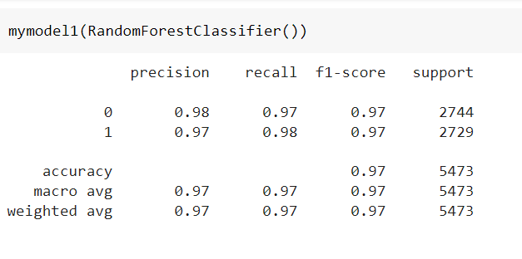
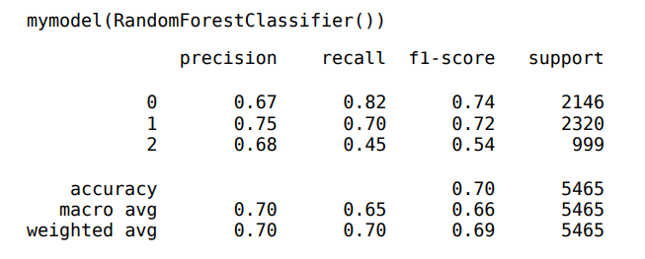
Comparison of Pre and Post Drug Accuracy
Post Drug Accuracy
Pre Drug Accuracy

Slide 15
Thank You

